Slide 1

Normalization vs. Denormalization
Database design strategies: balancing correctness and performance. This deck explains when to organise data into clean, related tables (normalization) versus when to duplicate for faster reads (denormalization).

Slide 2

The Core Problem — A Simple Analogy
Imagine a file cabinet where the same customer information appears on many pages. Updating that customer's phone number means hunting through dozens of records — slow and error-prone. The trade-off: fewer duplicates (clean, many lookups) vs. duplicates everywhere (fast reads).

Slide 3

What Is Normalization?
Normalization organises data to eliminate redundancy by splitting it into related tables. Principle: "write once, reference everywhere." The primary benefit is data integrity — a single source of truth for each attribute.

Slide 4
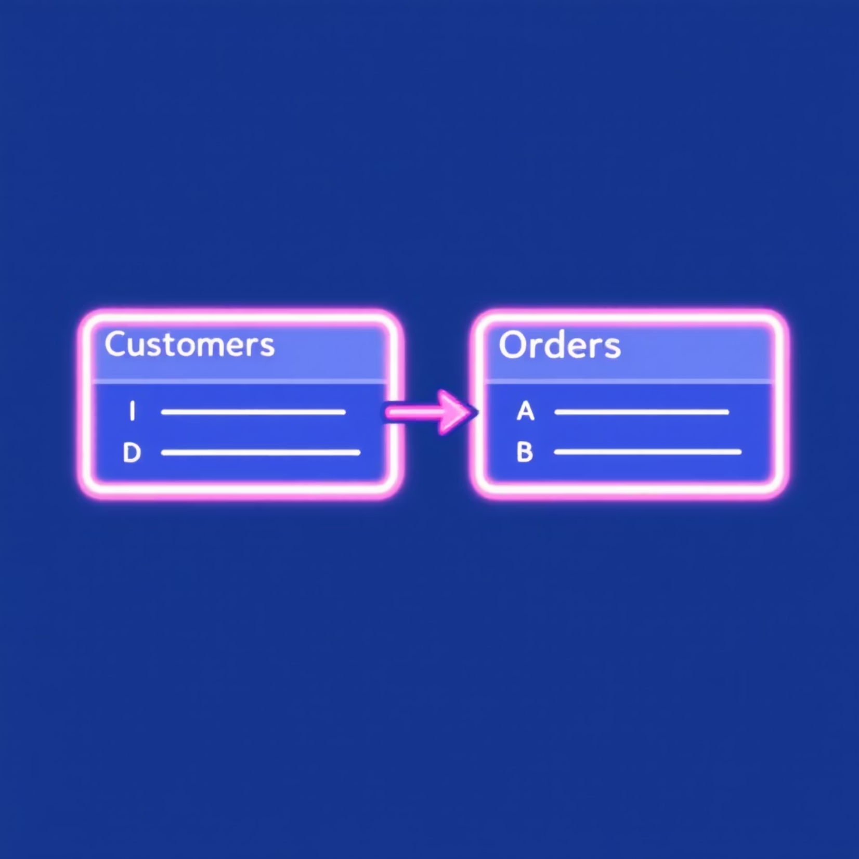
How Normalization Works
Example: Online Bookstore
Customers table holds ID and address. Orders table stores Cust_ID as a foreign key. When address changes, update once — all orders reflect the new address.

Slide 5

Benefits & Trade-offs of Normalization
Integrity
Storage Efficiency
Single place for each piece of data reduces inconsistency and anomalies.
Less duplicated data; lower disk usage and cleaner backups.
Write Performance
Query Complexity
Updates and inserts are focused; fewer places to change state.
Reads often require joins across tables, which can be slower for large analytical queries.

Slide 6

What Is Denormalization?
Denormalization intentionally duplicates data into wider tables or aggregates so reads require fewer joins. The goal is read performance — ideal for reporting, dashboards, and precomputed views.

Slide 7


Denormalization Example — Fast Read
Big_Sales_Report table keeps order, customer name, address and product together. Quick to query for reports or export, but updates require changing many rows when customer details change.

Slide 8
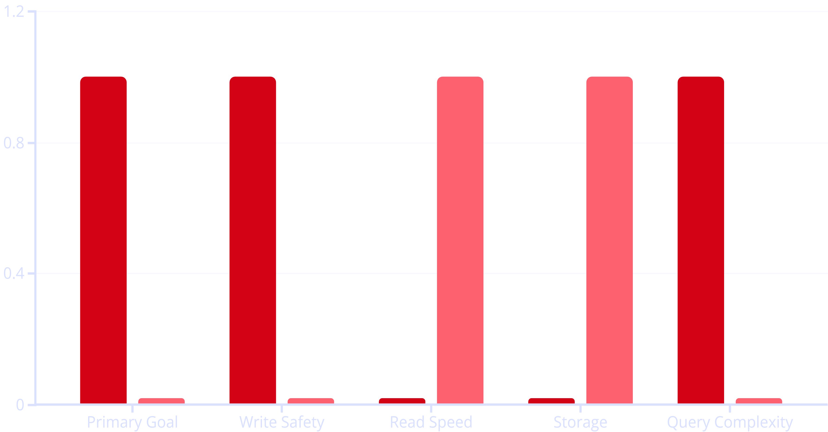
Normalization vs Denormalization — Quick Comparison
Normalization
Denormalization
Legend: 1 = stronger advantage for the labeled approach, 0 = weaker. Use this to quickly decide which property matters more for your system.

Slide 9
When to Use Each — Practical Guidance
Hybrid Approach
Use Denormalization (OLAP)
Normalise the OLTP core, then build denormalized read models (materialized views, read replicas, ETL outputs) for performance-sensitive queries.
Use Normalization (OLTP)
Analytical systems — data warehouses, dashboards, historical reporting. Read-heavy workloads benefit from pre-joined or aggregated tables and materialized views.
Transactional systems — banking, order processing, user profiles. Frequent writes and strict consistency requirements. Prioritise data integrity and minimal storage.

